Slide 1
Elo rating system
It is a numerical rating system that was originally invented by Arpad Elo, a Hungarian-American physics professor and chess player.
The Elo rating system is based on the idea that a player's rating should reflect their probability of winning against another player. The higher a player's rating, the more likely they are to win against a lower-rated player.
Lee Sedol: 3,778
Ke Jie: 3,766
AlphaGo: 3,900
AlphaZero: 4,823

Slide 2
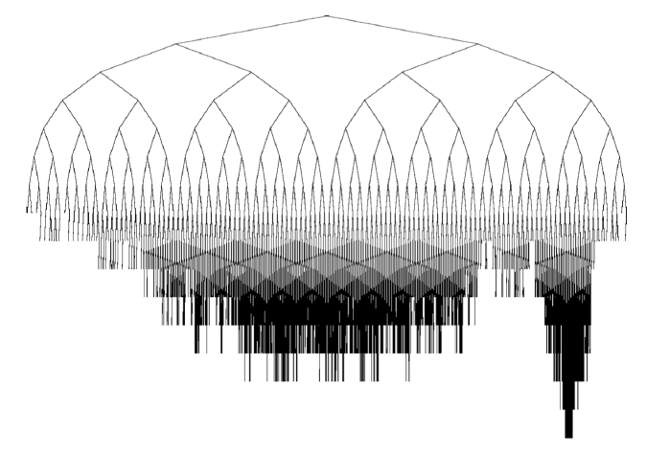
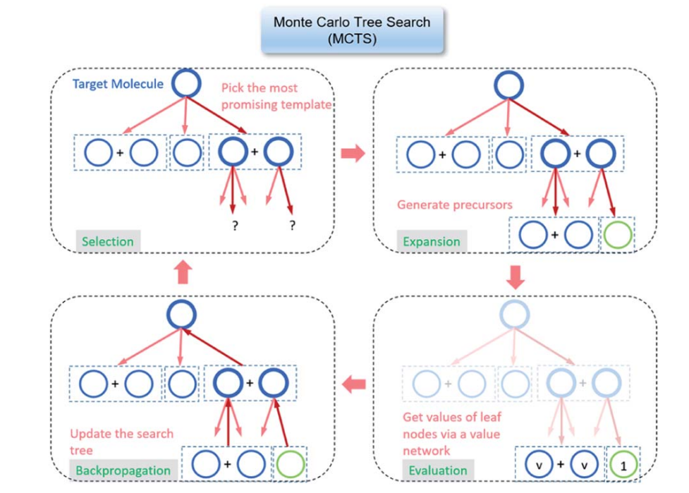
Monte Carlo tree search (MCTS)
a probabilistic algorithm for searching through a game tree.
Go, chess, and shogi.
main steps: selection, expansion, simulation, and backpropagation.
a powerful tool for searching through game trees.

Slide 3
Perceptron 1957
Gradient Descent 1951
Logistic regression 1958
Multiple layer neural networks 1969
Backpropagation 1974
Deep Learning 2006
ImageNet Challenge 2012
AlphaGo 2016
AlphaZero 2017
Transformer 2018
Attension
Scale Law 2019
generate more creative text formats
to translate more accurately
chatGPT 3.0 2020
Feature | ChatGPT3.0 | ChatGPT3.5 | ChatGPT4.0
Number of parameters | 137M | 150M | 1.75B
Training data | 1.56B | 2B | 600B tokens
Scaling laws | Linear | Sublinear | Superlinear
chatGPT 3.5 2022
chatGPT 4 2023

Slide 4
Year | Algorithm | Description
1800s | Regression | A statistical method that predicts the value of a dependent variable based on the values of one or more independent variables.
1943 | Neural networks | A type of machine learning algorithm that is inspired by the structure of the human brain.
1951 | Gradient Descent | A method for finding the minimum of a function.
1957 | Perceptron | A simple machine learning algorithm that can be used to classify binary data.
1958 | Logistic regression | A statistical method that predicts the probability of a binary outcome based on the values of one or more independent variables.
1963 | ADALINE | A type of perceptron that uses a differentiable activation function, making it more adaptable to different types of data.
1969 | Multiple layer neural networks | A type of neural network that has more than one layer of neurons.
1974 | Backpropagation | A method for training neural networks.
2006 | Deep learning | A type of machine learning that uses deep neural networks.

